Slide 1


Lixian Xi
@pragma 19
Changchun, Jilin,Sep 15,2010
College of Computer Science and Technology, Jilin University, ChangChun, P.R.China

Slide 2
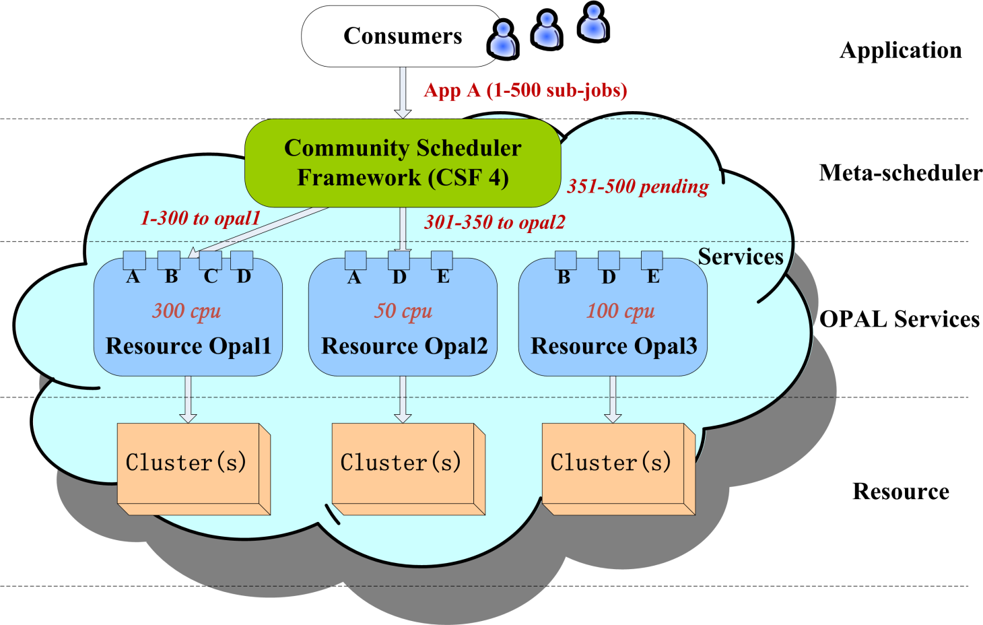
Overview

Slide 3
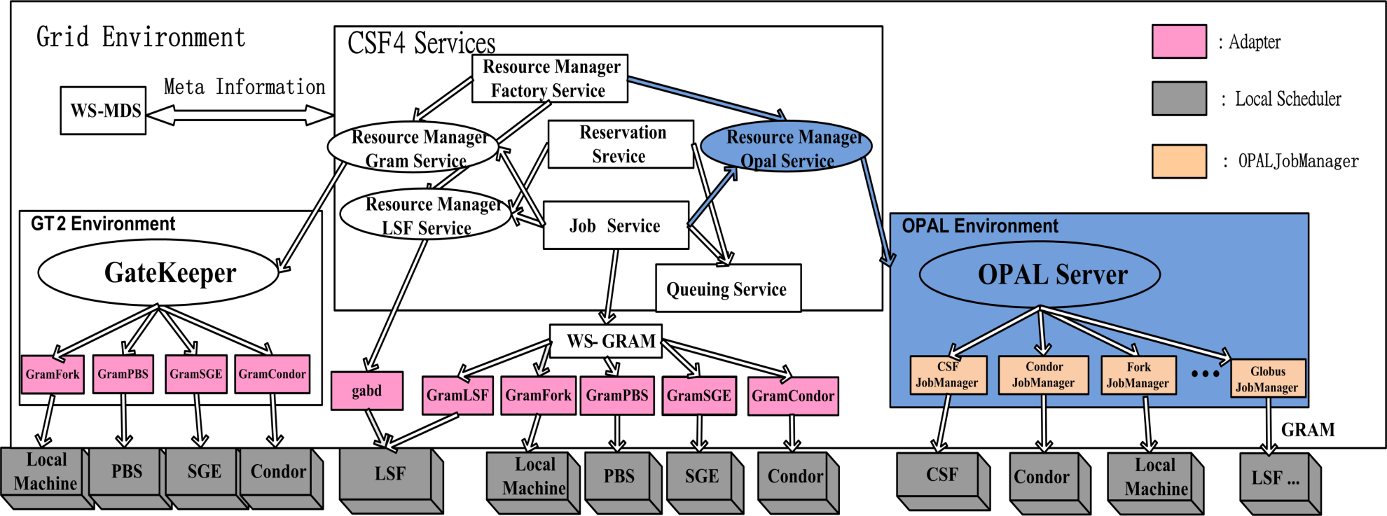
Framework in CSF

Slide 4
schedPluginOpal
schedue policy
    Sort resource
    Select candidate resources
    Match job with resource
ResourceManagerOpal
    SOAP
    Monitor job status

Slide 5
CSF4-OPAL demo
  Two OPAL resources:
  vm2-opal
  10 cpu
  vm4-opal
  7 cpu

Slide 6

Configuration for CSF Resource Manager
<cluster>
<name> vm2-opal </name>
<type> OPAL </type>
<host> vm2.jlu.edu.cn </host>
<port> 8080 </port>
<version>2.4</version>
</cluster>
<cluster>
<name> vm4-opal </name>
<type> OPAL </type>
<host> vm4.jlu.edu.cn </host>
<port> 8080 </port>
<version>2.4</version>
</cluster>

Slide 7
Step1 – query clusters available
Step2 – query opal service available
Step3 – submit job to OPAL
Step4 – query job status
Step5 – check the output file

Slide 8
CSF-OPAL demo1
Get opal resources available
  $csf-resouce-list

Slide 9
CSF-OPAL: demo2
Get opal services available
  $csf-service-list

Slide 10
CSF-OPAL demo3
Submit a autodock Job to OPAL resources
  $csf-job-create –r autodock100.rsl –n autodockJob

Slide 11
CSF-OPAL demo4
Get job status information according to job id.
  $csf-job-status autodockJob

Slide 12
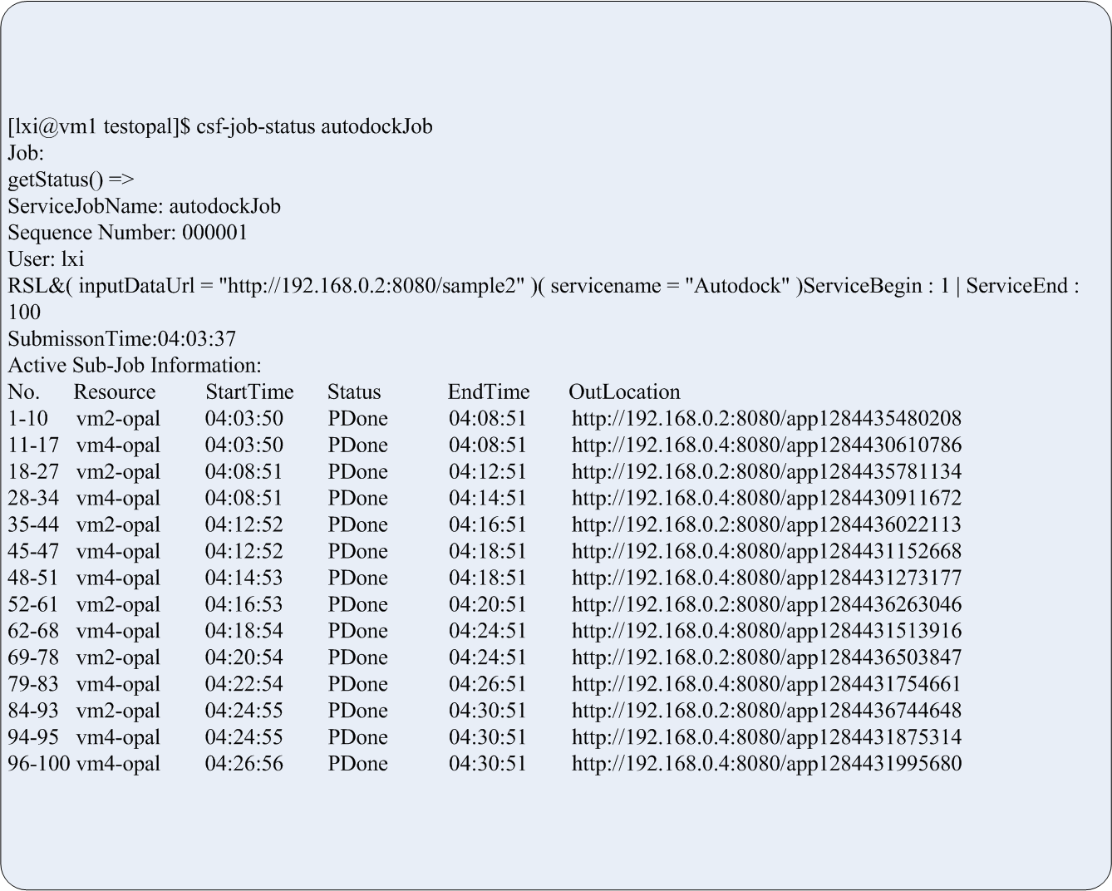

Slide 13
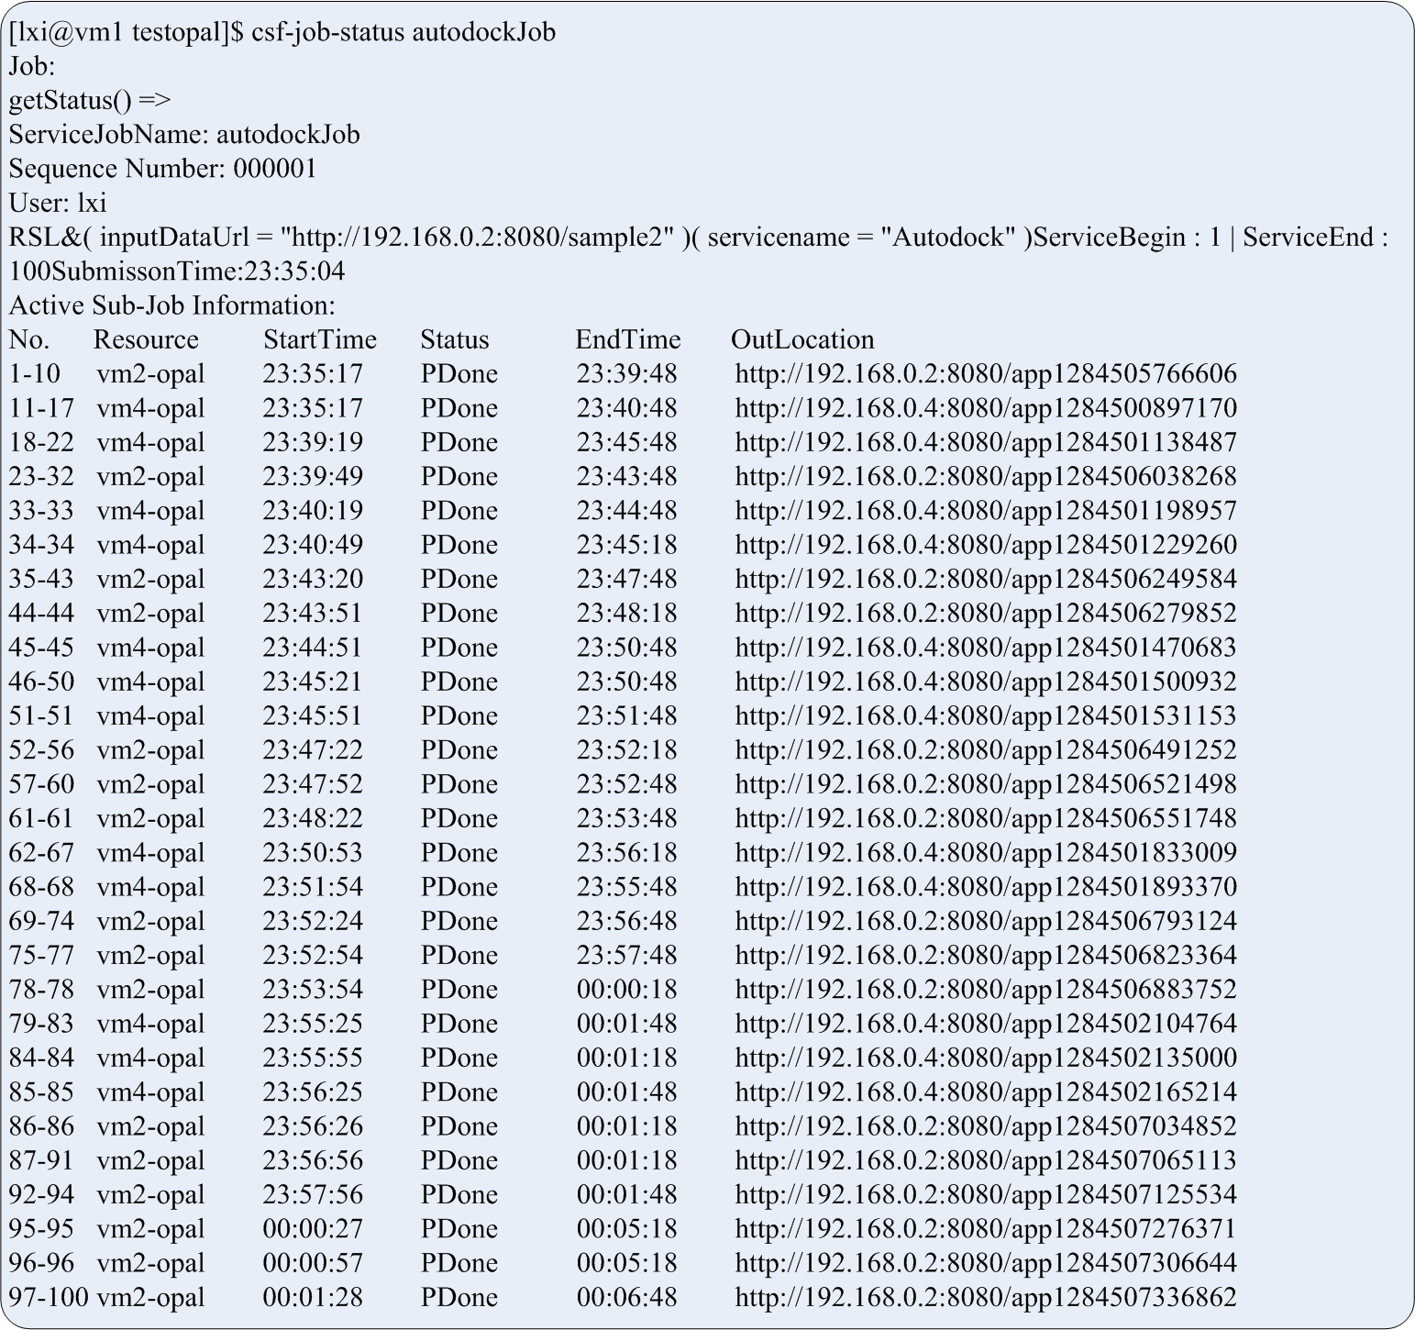

Slide 14
CSF-OPAL demo5
Check the output files
  http://192.168.0.4:8080/....

Slide 15
Thank you!

